Slide 1
CSIT988/CSIT488 Security, Ethics and Professionalism Week 11: Protection mechanisms
Subject Coordinator: Guangyou Zhou
Central China Normal University
Spring 2024

Slide 2
Week | Lecture Topics | Readings
1 | Introduction and overview of the subject | Chapter 1 / No Tutorials
2 | Information security management | Chapter 1
3 | Planning for security | Chapter 2
4 | Planning for contingencies | Chapter 3
5 | Information security policy | Chapter 4
7 | Developing the security program | Chapter 5
8 | Security management models & practices | Chapter 6, 7
9 | Risk management: identifying and accessing risk | Chapter 8
10 | Risk management: controlling risk | Chapter 9
11 | Protection mechanisms | Chapter 10
12 | Personnel and security | Chapter 11
13 | Law and Ethics Exam Review | Chapter 12

Slide 3
Introduction
Technical controls
Usually an essential part of information security programs
Insufficient if used alone
Must be combined with sound policy and education, training, and awareness efforts
Examples of technical security mechanisms
Access controls, firewalls, dial-up protection, intrusion detection systems, scanning and analysis tools, and encryption systems

Slide 4
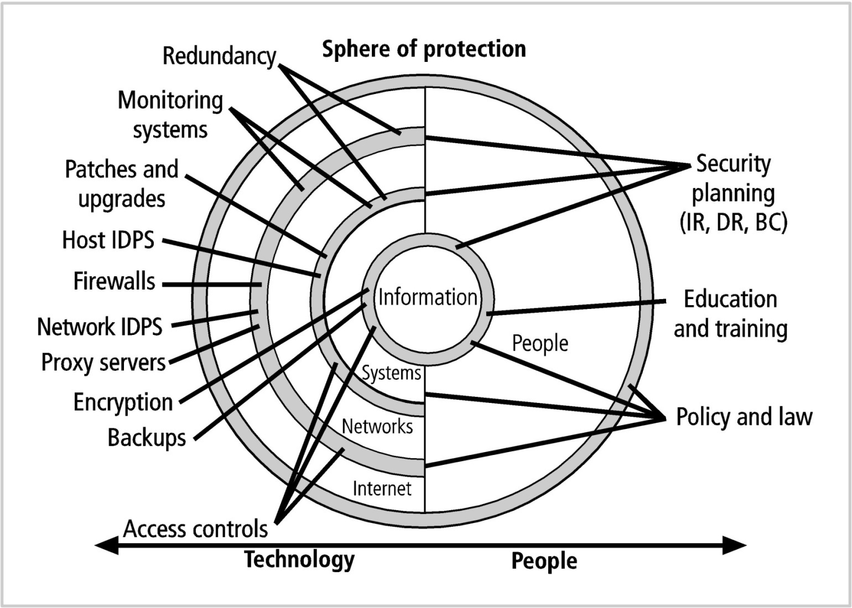
Introduction (cont’d.)

Slide 5
Access Controls
The four processes of access control
Identification
Obtaining the identity of the person requesting access to a logical or physical area
Authentication
Confirming the identity of the person seeking access to a logical or physical area
Authorization
Determining which actions that a person can perform in that physical or logical area
Accountability
Documenting the activities of the authorized individual and systems
A successful access control approach always incorporates all four of these elements

Slide 6
Identification
A mechanism that provides information about a supplicant that requests access
Identifier (ID)
The label applied to the supplicant
Must be a unique value that can be mapped to one and only one entity within the security domain
Examples: name, first initial and surname

Slide 7
Authentication
Authentication mechanism types
Something you know: password, passphrase
Something you have: cryptographic token or smart card
Something you are: fingerprints, palm prints
Something you produce: voice, signature
Strong authentication
Uses at least two different authentication mechanism types

Slide 8
Authentication (cont’d.)
Something you know
A password, passphrase, or other unique code
A password is a private word or combination of characters that only the user should know
A passphrase is a plain-language phrase, typically longer than a password, from which a virtual password is derived
Passwords should be at least eight characters long and contain at least one number and one special character

Slide 9
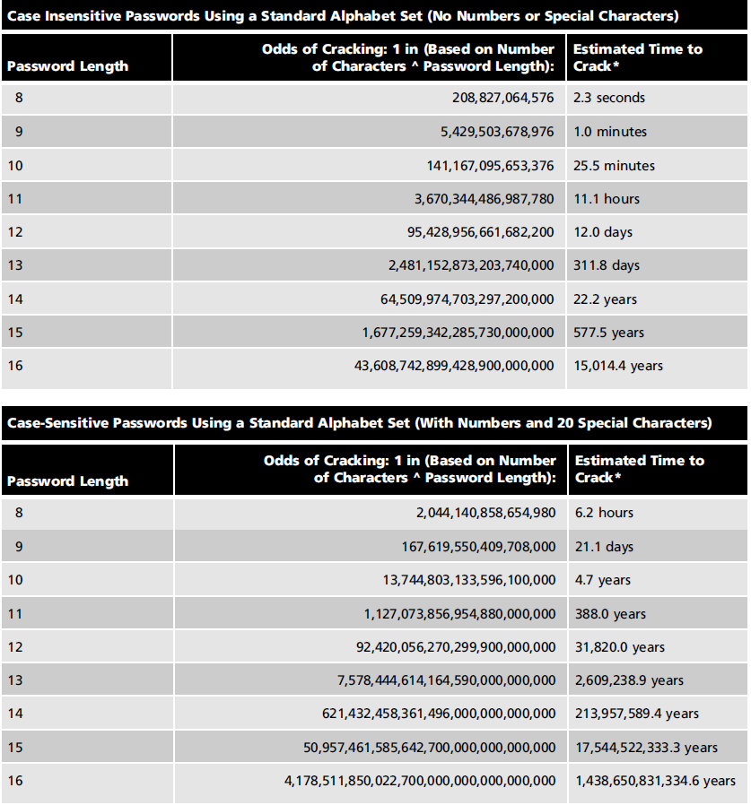

Slide 10
Authentication (cont’d.)
Something you have
Something that the user or system possesses
Examples:
A card, key, or token
A dumb card (such as an ATM card) with magnetic stripes
A smart card containing a processor
A cryptographic token (a processor in a card that has a display)
Tokens may be either synchronous or asynchronous

Slide 11
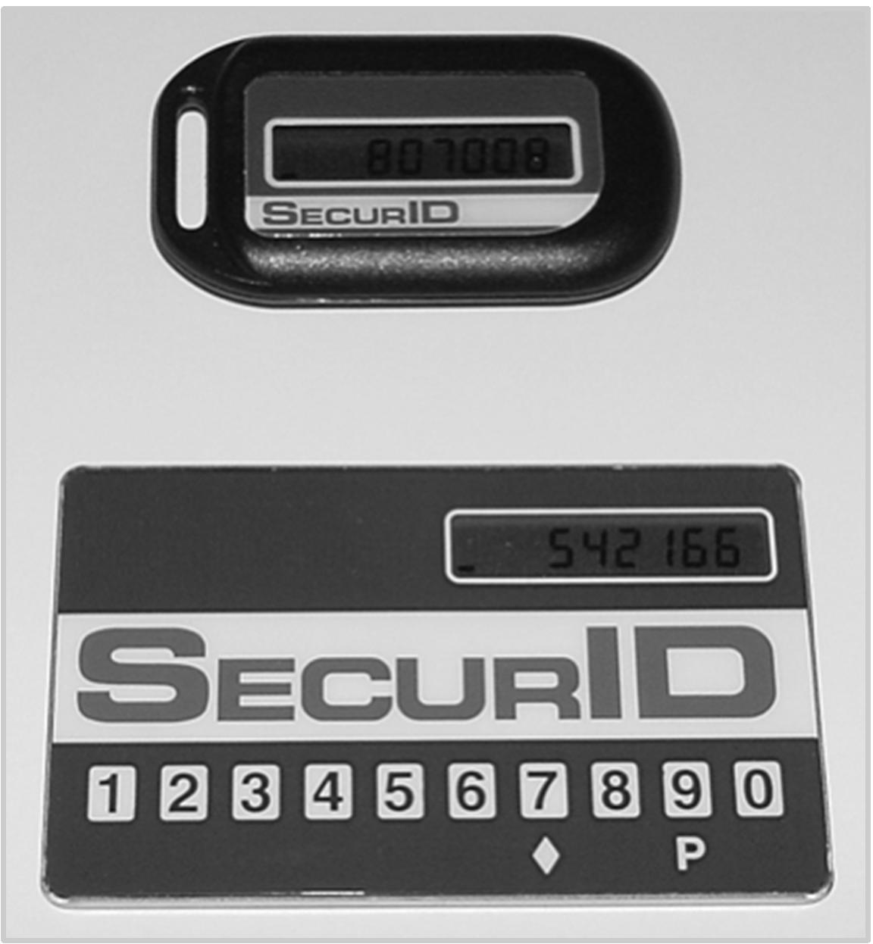
Authentication (cont’d.)

Slide 12
Authentication (cont’d.)
Something you are
Something inherent in the user that is evaluated using biometrics
Most technologies that scan human characteristics convert the images to obtain minutiae (unique points of reference that are digitized and stored in an encrypted format)
Something you produce
Something the user performs or produces
Includes technology related to signature recognition and voice recognition

Slide 13
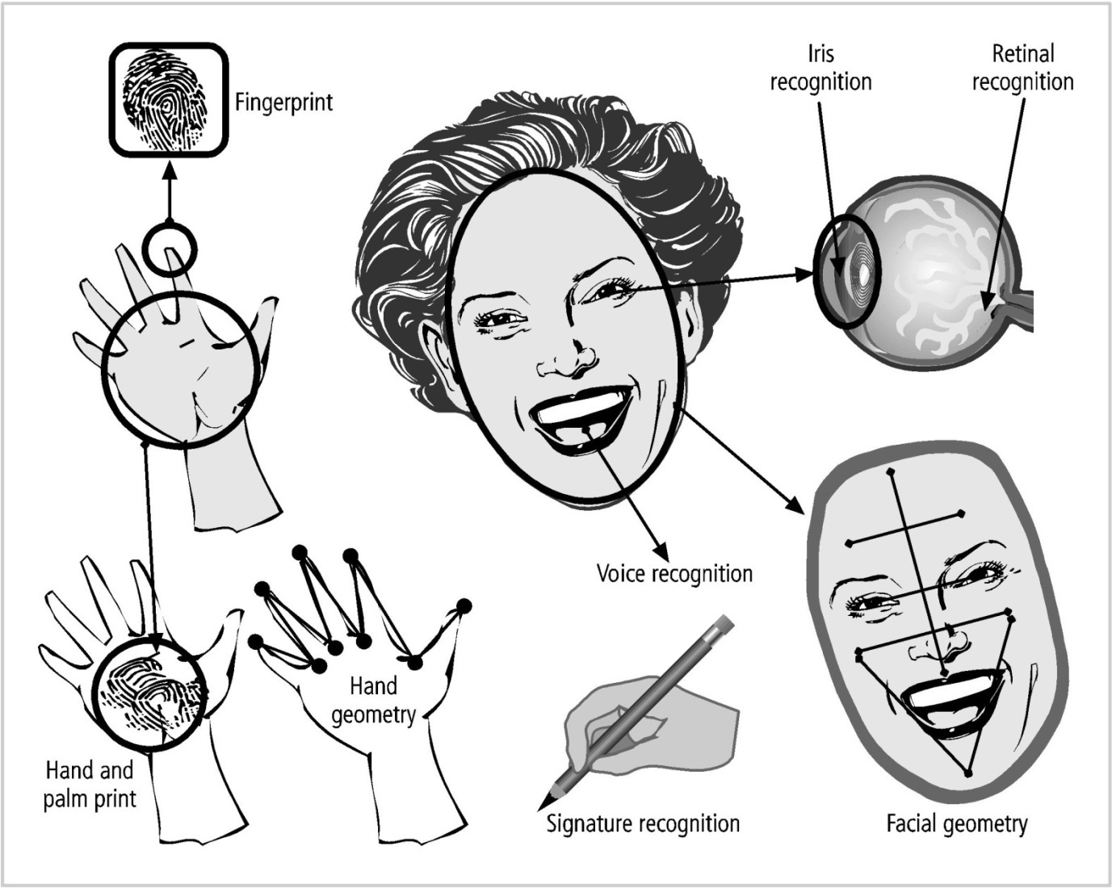
Authentication (cont’d.)

Slide 14
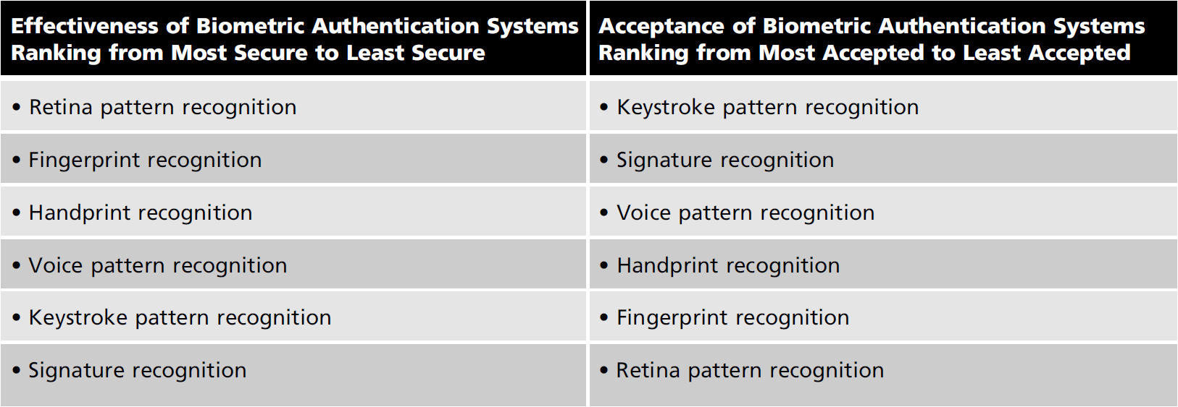
Authentication (cont’d.)

Slide 15
Managing Access Controls
A formal access control policy
Determines how access rights are granted to entities and groups
Includes provisions for periodically reviewing all access rights, granting access rights to new employees, changing access rights when job roles change, and revoking access rights as appropriate

Slide 16
Firewalls
Any device that prevents a specific type of information from moving between two networks
Between the outside (untrusted network: e.g., the Internet), and the inside (trusted network)
May be a separate computer system
Or a service running on an existing router or server
Or a separate network with a number of supporting devices

Slide 17
The Development of Firewalls
Packet filtering firewalls
First generation firewalls
Simple networking devices that filter packets by examining every incoming and outgoing packet header
Selectively filter packets based on values in the packet header
Can be configured to filter based on IP address, type of packet, port request, and/or other elements present in the packet

Slide 18
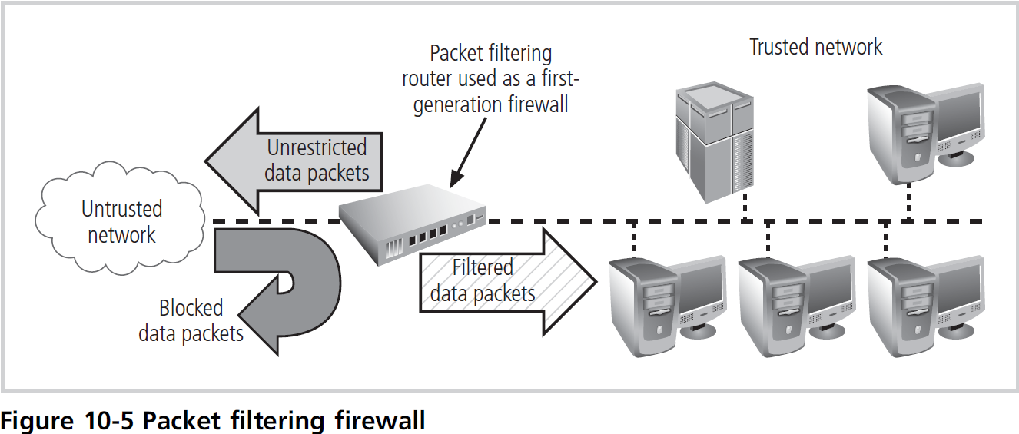
The Development of Firewalls

Slide 19
The Development of Firewalls (cont’d.)
Application-level firewalls
Second generation firewalls
Consists of dedicated computers kept separate from the first filtering router (edge router)
Commonly used in conjunction with a second or internal filtering router - or proxy server
The proxy server, rather than the Web server, is exposed to the outside world from within a network segment called the demilitarized zone (DMZ), an intermediate area between a trusted network and an untrusted network

Slide 20
The Development of Firewalls (cont’d.)
Application-level firewalls (cont’d.)
Implemented for specific protocols
Stateful inspection firewalls
Third generation firewalls
Keeps track of each network connection established between internal and external systems using a state table
State tables track the state and context of each packet exchanged by recording which station sent which packet and when

Slide 21
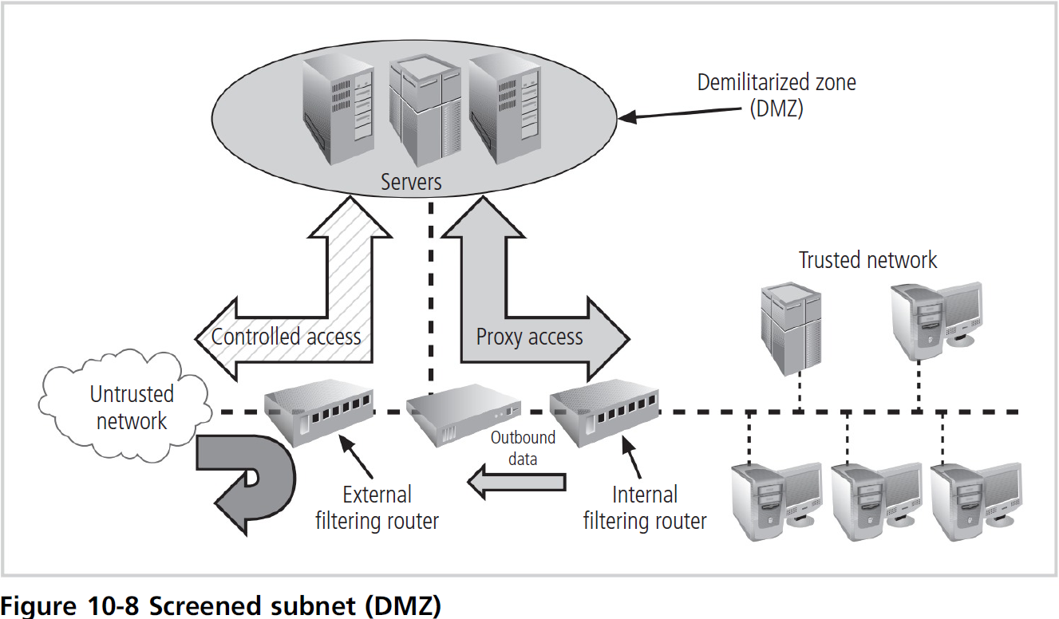
The Development of Firewalls (cont’d.)

Slide 22
The Development of Firewalls (cont’d.)
Stateful inspection firewalls (third generation)
Can restrict incoming packets by allowing access only to packets that constitute responses to requests from internal hosts
If the stateful inspection firewall receives an incoming packet that it cannot match to its state table
It uses ACL rights to determine whether to allow the packet to pass

Slide 23
The Development of Firewalls (cont’d.)
Dynamic packet filtering firewall
Fourth generation firewall
Allows only a particular packet with a specific source, destination, and port address to pass through the firewall
Understands how the protocol functions, and opens and closes firewall pathways
An intermediate form between traditional static packet filters and application proxies

Slide 24
Firewall Architectures
Each firewall generation can be implemented in several architectural configurations
Common architectural implementations
Packet filtering routers
Screened-host firewalls
Dual-homed host firewalls
Screened-subnet firewalls

Slide 25
Firewall Architectures (cont’d.)
Packet filtering routers
Most organizations with an Internet connection use some form of router between their internal networks and the external service provider
Many can be configured to block packets that the organization does not allow into the network
Such an architecture lacks auditing and strong authentication
The complexity of the access control lists used to filter the packets can grow to a point that degrades network performance

Slide 26
Firewall Architectures (cont’d.)
Screened-host firewall systems
Combine the packet filtering router with a separate, dedicated firewall such as an application proxy server
Allows the router to screen packets
Minimizes network traffic and load on the internal proxy
The application proxy examines an application layer protocol, such as HTTP, and performs the proxy services
Bastion host
A single, rich target for external attacks
Should be very thoroughly secured

Slide 27
Firewall Architectures (cont’d.)
Dual-homed host firewalls
The bastion host contains two network interfaces
One is connected to the external network
One is connected to the internal network
Requires all traffic to travel through the firewall to move between the internal and external networks
Network-address translation (NAT) is often implemented with this architecture, which converts external IP addresses to special ranges of internal IP addresses
Dual-homed host firewalls (cont’d.)
These special, non-routable addresses consist of three different ranges:
10.x.x.x: greater than 16.5 million usable addresses
192.168.x.x: greater than 65,500 addresses
172.16.0.x - 172.16.15.x: greater than 4000 usable addresses

Slide 28
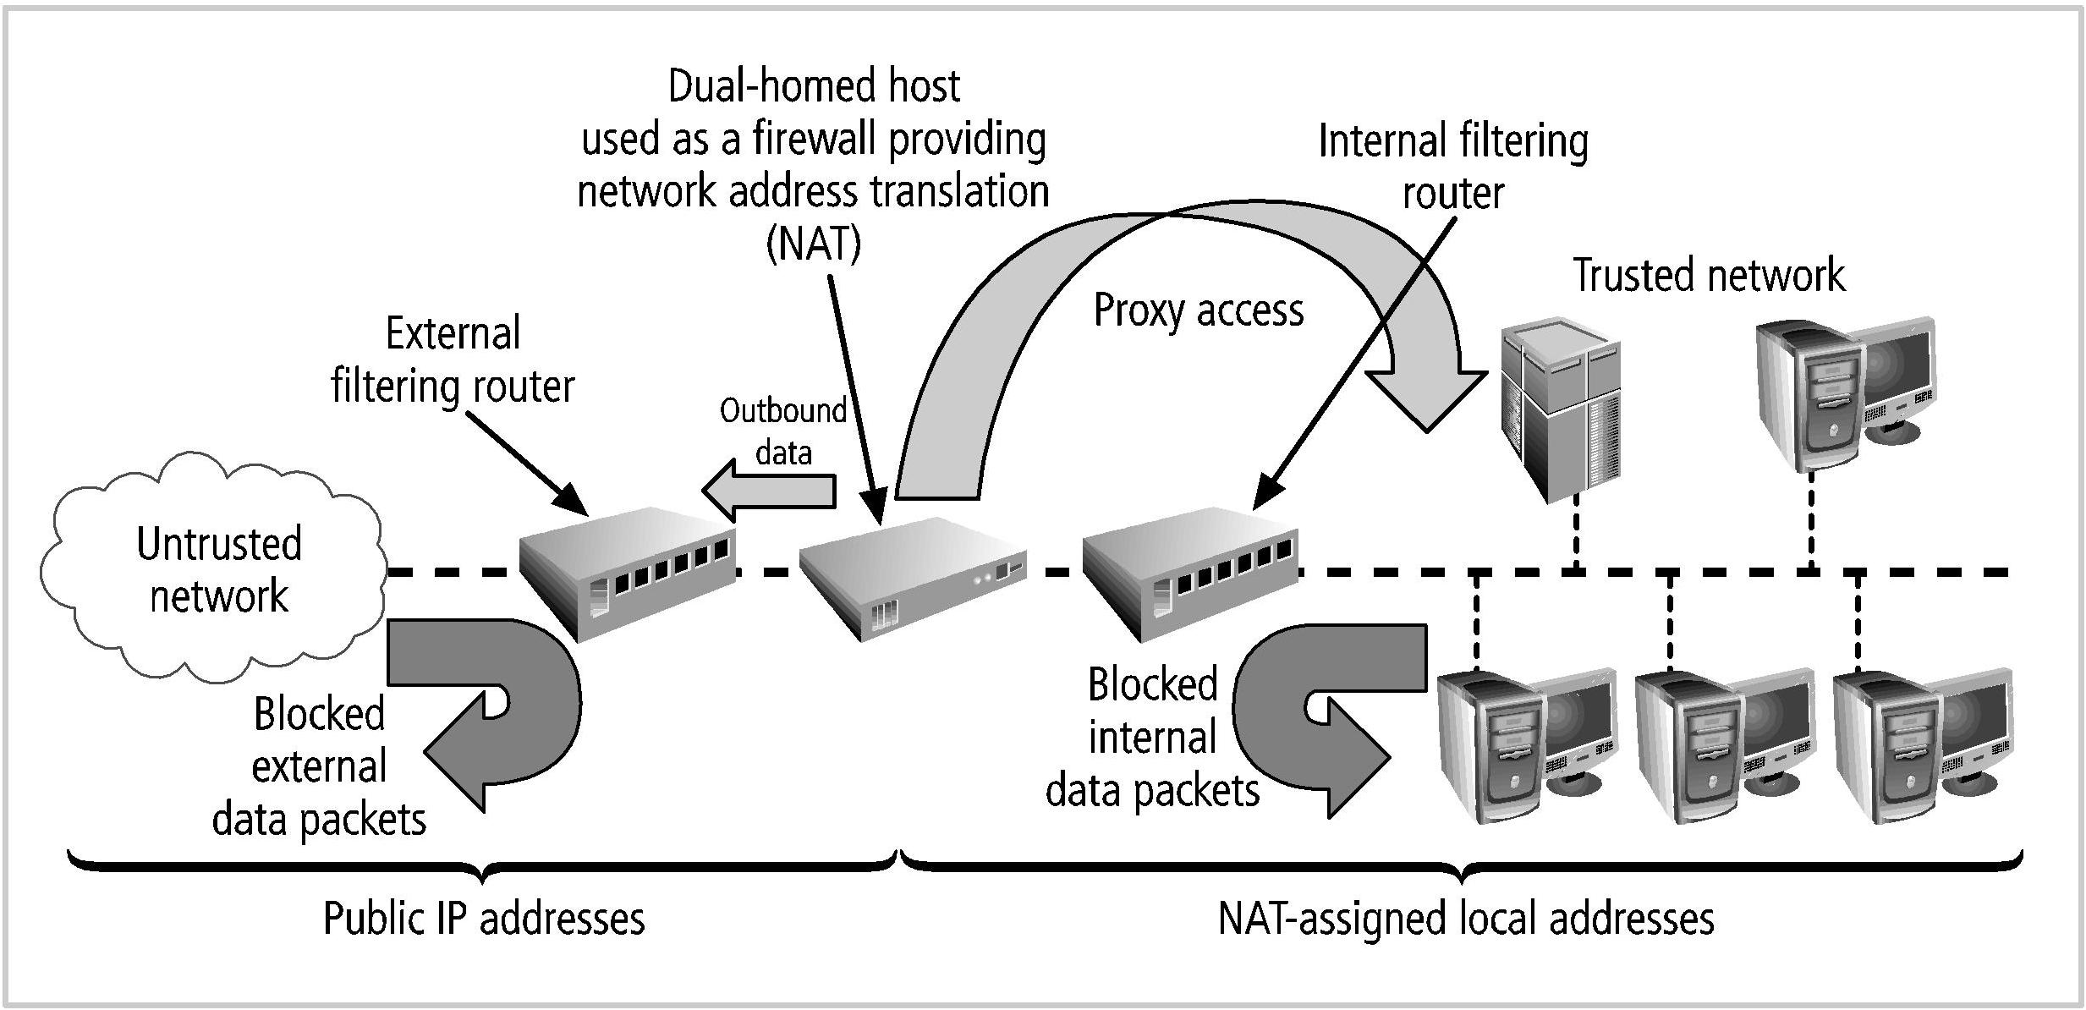
Firewall Architectures (cont.)

Slide 29
Firewall Architectures (cont.)
Screened-Subnet Firewalls
Consists of one or more internal bastion hosts located behind a packet filtering router, with each host protecting the trusted network
The first general model uses two filtering routers, with one or more dual-homed bastion hosts between them
The second general model shows connections routed as follows:
Connections from the untrusted network are routed through an external filtering router
Connections from the untrusted network are routed into—and then out of—a routing firewall to the separate network segment known as the DMZ
Second general model (cont’d.)
Connections into the trusted internal network are allowed only from the DMZ bastion host servers

Slide 30
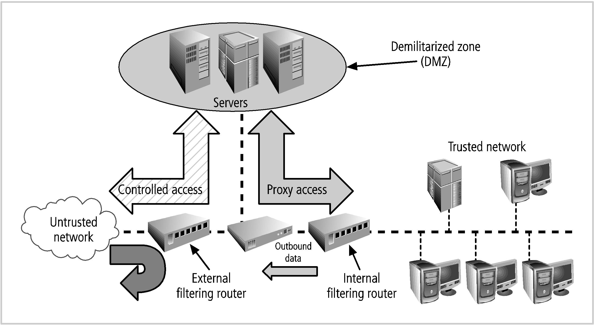
Firewall Architectures (cont.)

Slide 31
Selecting the Right Firewall
Questions to ask when evaluating a firewall:
Firewall technology:
What type offers the right balance between protection and cost for the organization’s needs?
Cost:
What features are included in the base price? At extra cost? Are all cost factors known?
Maintenance:
How easy is it to set up and configure the firewall?
How accessible are the staff technicians who can competently configure the firewall?
Future growth:
Can the candidate firewall adapt to the growing network in the target organization?

Slide 32
Intrusion Detection and Prevention Systems
The term intrusion detection/prevention system (IDPS) can be used to describe current anti-intrusion technologies
Can detect an intrusion
Can also prevent that intrusion from successfully attacking the organization by means of an active response

Slide 33
Intrusion Detection and Prevention Systems (cont’d.)
IDPSs work like burglar alarms
Administrators can choose the alarm level
Can be configured to notify administrators via e-mail and numerical or text paging
Like firewall systems, IDPSs require complex configurations to provide the level of detection and response desired

Slide 34
Intrusion Detection and Prevention Systems (cont’d.)
The newer IDPS technologies
Different from older IDS technologies
IDPS technologies can respond to a detected threat by attempting to prevent it from succeeding
Types of response techniques:
The IDPS stops the attack itself
The IDPS changes the security environment
The IDPS changes the attack’s content

Slide 35
Intrusion Detection and Prevention Systems (cont’d.)
IDPSs are either network based to protect network information assets
Or host based to protect server or host information assets
IDPS detection methods
Signature based
Statistical anomaly based

Slide 36
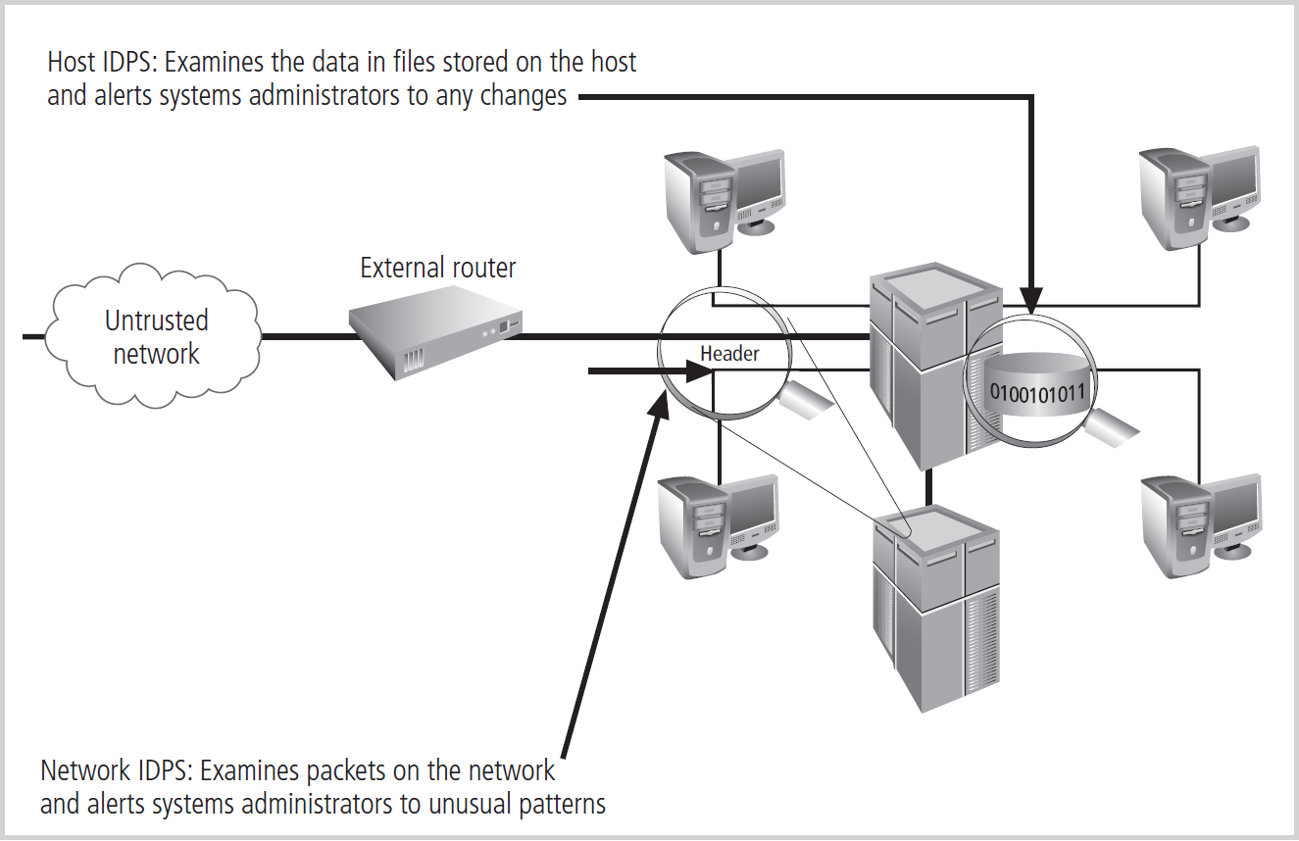
Intrusion Detection and Prevention Systems (cont’d.)

Slide 37
Host-Based IDPS
Configures and classifies various categories of systems and data files
IDPSs provide only a few general levels of alert notification
Unless the IDPS is very precisely configured, benign actions can generate a large volume of false alarms
Host-based IDPSs can monitor multiple computers simultaneously

Slide 38
Network-Based IDPS
Monitor network traffic
When a predefined condition occurs, notifies the appropriate administrator
Looks for patterns of network traffic
Match known and unknown attack strategies against their knowledge base to determine whether an attack has occurred
Yield many more false-positive readings than host-based IDPSs

Slide 39
Wireless Networking Protection
Most organizations that make use of wireless networks use an implementation based on the IEEE 802.11 protocol
The size of a wireless network’s footprint
Depends on the amount of power the transmitter/receiver wireless access points (WAP) emit
Sufficient power must exist to ensure quality connections within the intended area
But not allow those outside the footprint to connect

Slide 40
Wireless Networking Protection (cont’d.)
War driving
Moving through a geographic area or building, actively scanning for open or unsecured WAPs
Common encryption protocols used to secure wireless networks
Wired Equivalent Privacy (WEP)
Wi-Fi Protected Access (WPA)

Slide 41
Wired Equivalent Privacy (WEP)
Provides a basic level of security to prevent unauthorized access or eavesdropping
Does not protect users from observing each others’ data
Has several fundamental cryptological flaws
Resulting in vulnerabilities that can be exploited, which led to replacement by WPA

Slide 42
Wi-Fi Protected Access (WPA)
WPA is an industry standard
Created by the Wi-Fi Alliance
Some compatibility issues with older WAPs
IEEE 802.11i
Has been implemented in products such as WPA2
WPA2 has newer, more robust security protocols based on the Advanced Encryption Standard
WPA /WPA 2 provide increased capabilities for authentication, encryption, and throughput

Slide 43
Cryptography
Encryption
The process of converting an original message into a form that cannot be understood by unauthorized individuals
Cryptology
The science of encryption
Composed of two disciplines: cryptography and cryptanalysis

Slide 44
Cryptography (cont’d.)
Cryptology (cont’d.)
Cryptography
Describes the processes involved in encoding and decoding messages so that others cannot understand them
Cryptanalysis
The process of deciphering the original message (or plaintext) from an encrypted message (or ciphertext), without knowing the algorithms and keys used to perform the encryption

Slide 45
Cryptography (cont’d.)
Algorithm
A mathematical formula or method used to convert an unencrypted message into an encrypted message
Cipher
The transformation of the individual components of an unencrypted message into encrypted components
Ciphertext or cryptogram
The unintelligible encrypted or encoded message resulting from an encryption

Slide 46
Cryptography (cont’d.)
Cryptosystem
The set of transformations that convert an unencrypted message into an encrypted message
Decipher
To decrypt or convert ciphertext to plaintext
Encipher
To encrypt or convert plaintext to ciphertext

Slide 47
Cryptography (cont’d.)
Key
The information used in conjunction with the algorithm to create the ciphertext from the plaintext
Can be a series of bits used in a mathematical algorithm, or the knowledge of how to manipulate the plaintext

Slide 48
Cryptography (cont’d.)
Keyspace
The entire range of values that can possibly be used to construct an individual key
Plaintext
The original unencrypted message that is encrypted and results from successful decryption
Steganography
The process of hiding messages, usually within graphic images

Slide 49
Encryption Operations
Common ciphers
Most commonly used algorithms include three functions: substitution, transposition, and XOR
In a substitution cipher, you substitute one value for another
A monoalphabetic substitution uses only one alphabet
A polyalphabetic substitution uses two or more alphabets

Slide 50
Encryption Operations (cont’d.)
Transposition cipher (or permutation cipher)
Simply rearranges the values within a block to create the ciphertext
Can be done at the bit level or at the byte (character) level
XOR cipher conversion
The bit stream is subjected to a Boolean XOR function against some other data stream, typically a key stream

Slide 51
Encryption Operations (cont’d.)
XOR works as follows:
‘0’ XOR’ed with ‘0’ results in a ‘0’. (0 ⊗ 0 = 0)
‘0’ XOR’ed with ‘1’ results in a ‘1’. (0 ⊗ 1 = 1)
‘1’ XOR’ed with ‘0’ results in a ‘1’. (1 ⊗ 0 = 1)
‘1’ XOR’ed with ‘1’ results in a ‘0’. (1 ⊗ 1 = 0)
If the two values are the same, you get “0”; if not, you get “1”
Process is reversible; if you XOR the ciphertext with the key stream, you get the plaintext

Slide 52
Encryption Operations (cont’d.)
Symmetric encryption
Known as private key encryption, or symmetric encryption
The same key (a secret key) is used to encrypt and decrypt the message
Methods are usually extremely efficient
Requiring easily accomplished processing to encrypt or decrypt the message
Challenge in symmetric key encryption is getting a copy of the key to the receiver

Slide 53
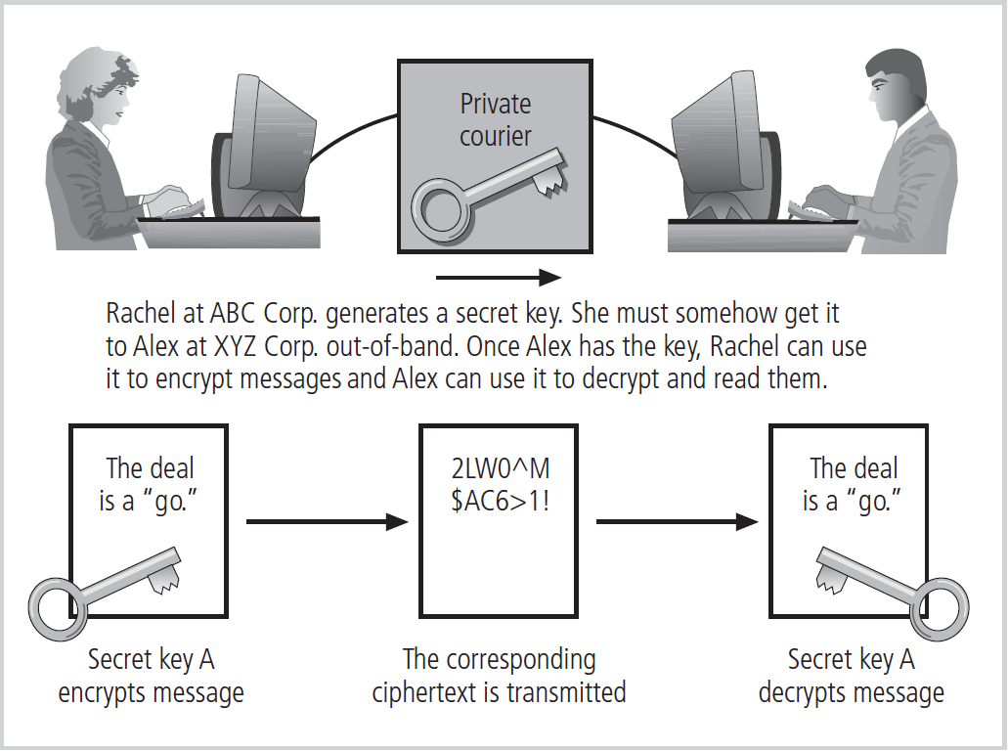
Encryption Operations (cont’d.)

Slide 54
Encryption Operations (cont’d.)
Asymmetric encryption
Also known as public key encryption
Uses two different, but related keys
Either key can be used to encrypt or decrypt the message
However, if Key A is used to encrypt the message, then only Key B can decrypt it; conversely, if Key B is used to encrypt a message, then only Key A can decrypt it
This technique is most valuable when one of the keys is private and the other is public
Problem: it requires four keys to hold a single conversation between two parties, and the number of keys grows geometrically as parties are added

Slide 55
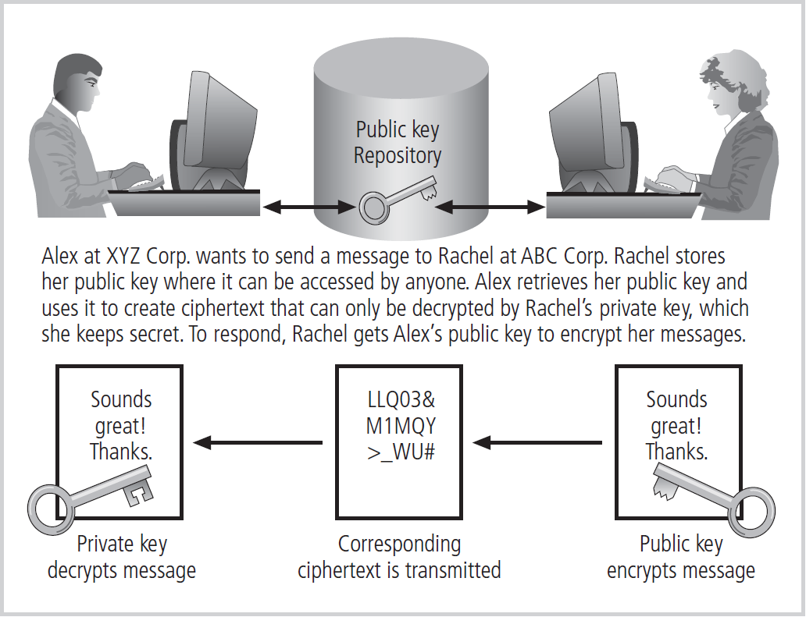
Encryption Operations (cont’d.)

Slide 56
Encryption Operations (cont’d.)
Digital signatures
Encrypted messages that are independently verified by a central facility (registry) as authentic
When the asymmetric process is reversed, the private key encrypts a message, and the public key decrypts it
The fact that the message was sent by the organization that owns the private key cannot be refuted
This nonrepudiation is the foundation of digital signatures

Slide 57
Encryption Operations (cont’d.)
Digital certificate
An electronic document, similar to a digital signature, attached to a file certifying that the file is from the organization it claims to be from and has not been modified from the original format
A certificate authority (CA)
An agency that manages the issuance of certificates and serves as the electronic notary public to verify their origin and integrity

Slide 58
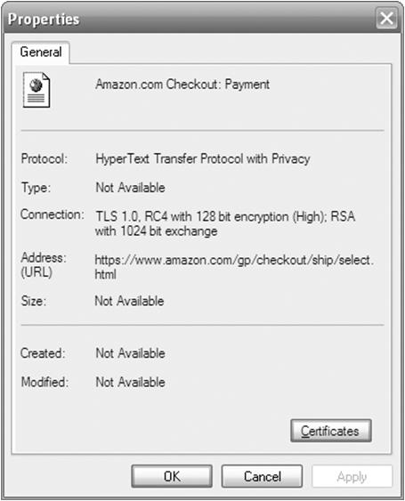
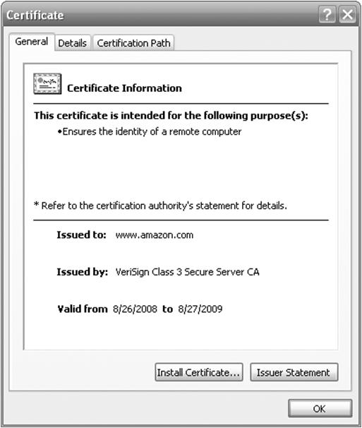
Encryption Operations (cont’d.)

Slide 59
Encryption Operations (cont’d.)
Hybrid systems
Pure asymmetric key encryption is not widely used except in the area of certificates
It is typically employed in conjunction with symmetric key encryption, creating a hybrid system
The hybrid process in current use is based on the Diffie-Hellman key exchange method, which provides a way to exchange private keys using public key encryption without exposure to any third parties

Slide 60
Encryption Operations (cont’d.)
Hybrid systems (cont’d.)
In this method, asymmetric encryption is used to exchange symmetric keys so that two organizations can conduct quick, efficient, secure communications based on symmetric encryption
Diffie-Hellman provided the foundation for subsequent developments in public key encryption

Slide 61
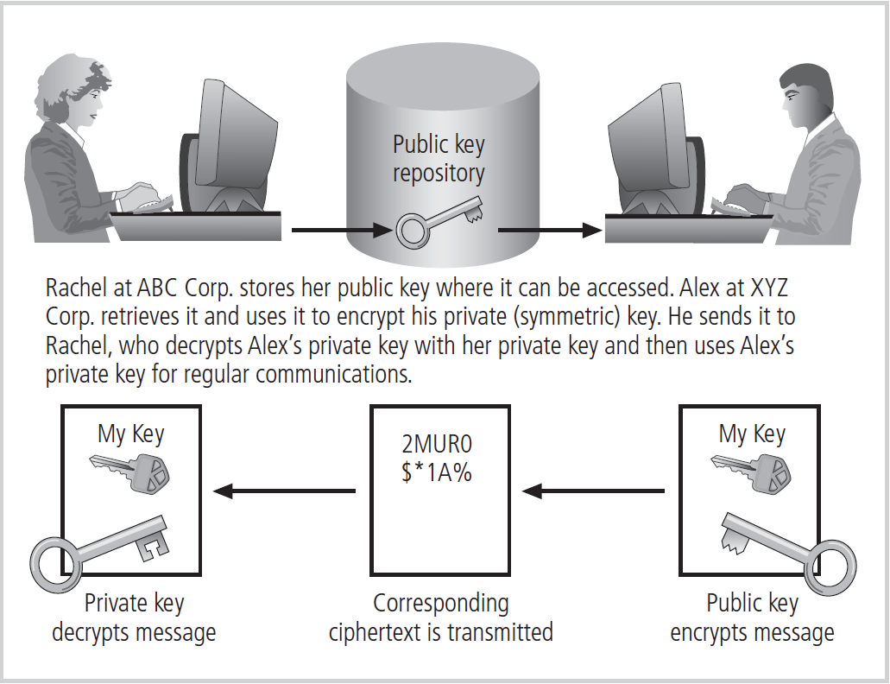
Encryption Operations (cont’d.)

